Slide 1
Actor Model Programming in .NET
Josh Lane - @jplane

Slide 2

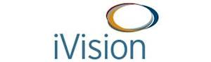
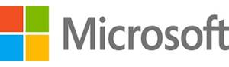
Platinum Sponsors

Slide 3
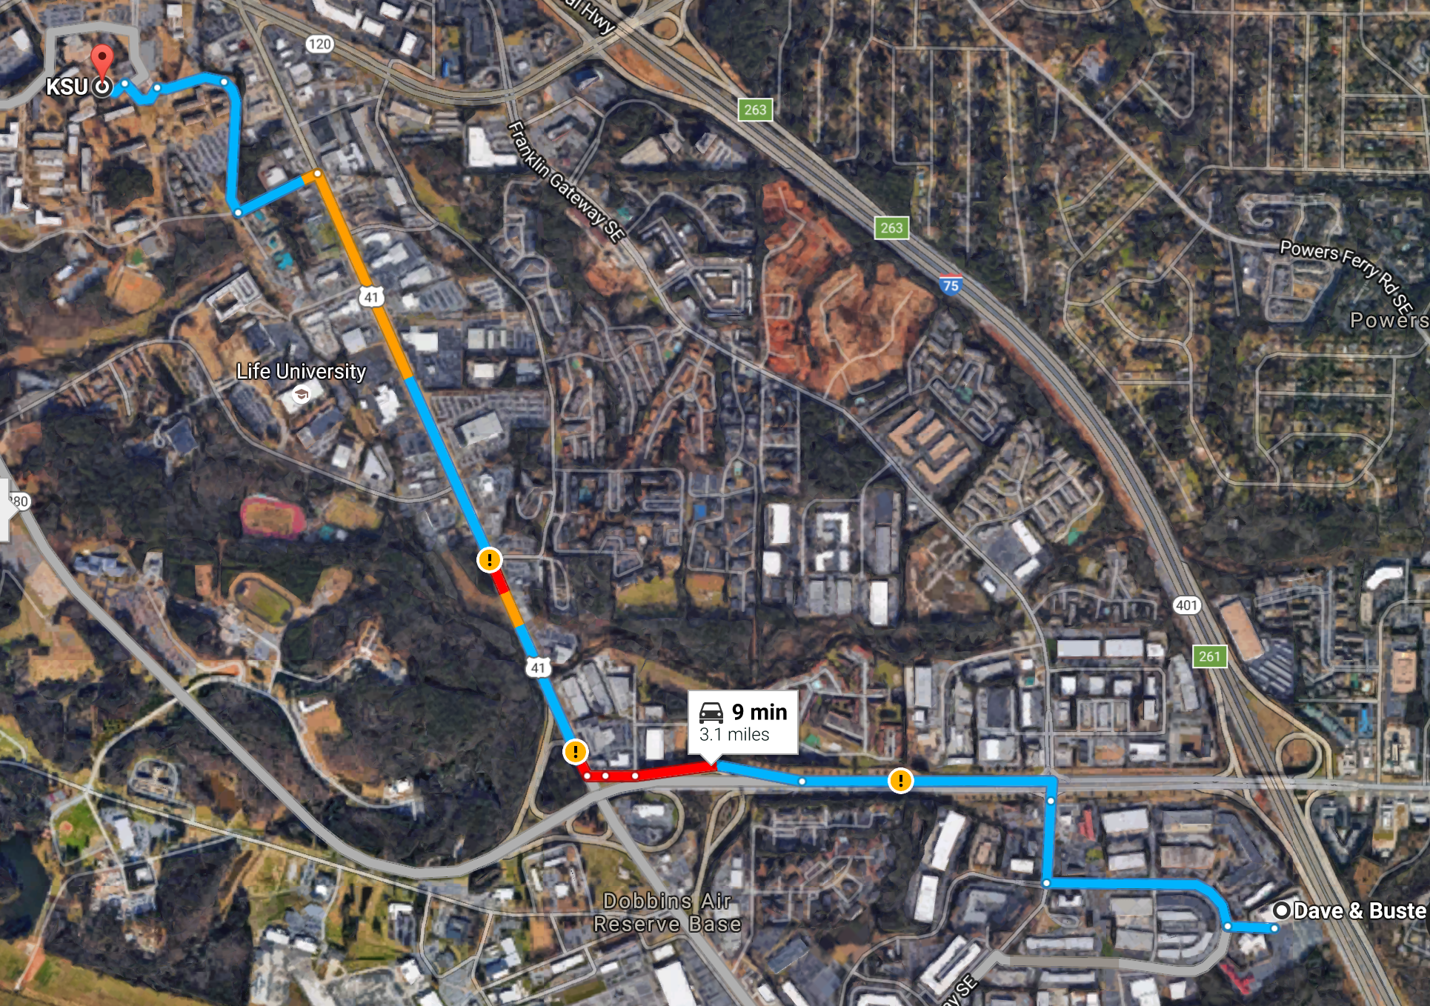

After Party – Dave & Busters
2215 D&B Drive Southeast Marietta, GA
Sponsored By:

Slide 4



Gold Sponsors

Slide 5
Silver Sponsors

Slide 6
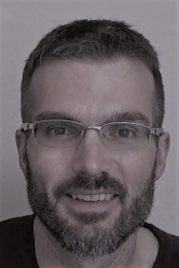
Hello World
Independent consultant
20+ years as a software developer, trainer, conference speaker, writer
Microsoft Azure MVP
Azure-in-the-ATL meetup founder

Slide 7
Why Actors?

Slide 8
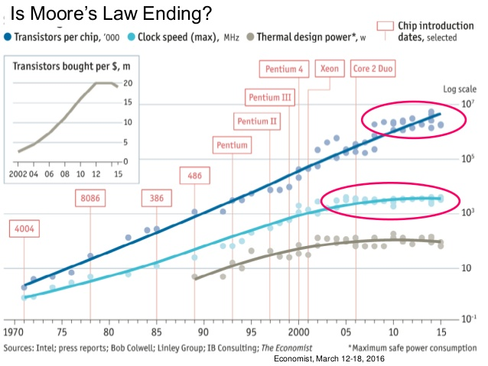
Scale-out Is Where Its At
Notes:
Chips speeds are not increasing like they used to… instead we’re using more cores. Need for programming models that simplify concurrency

Slide 9
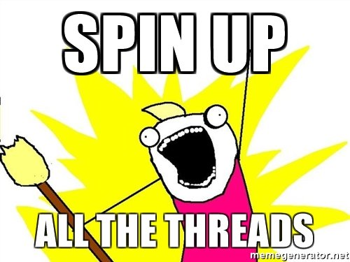

Threading Suuucks

Slide 10
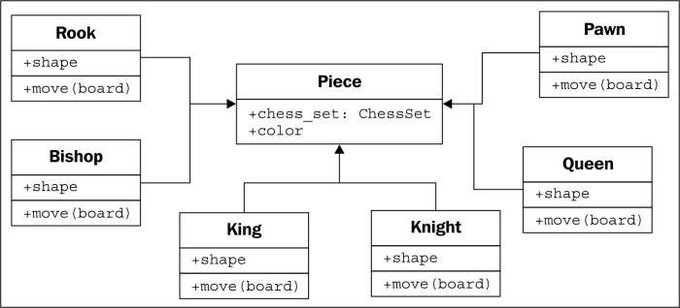
OO Programming Is Cool Again
Notes:
OO programming on the server (no layer cakes)

Slide 11
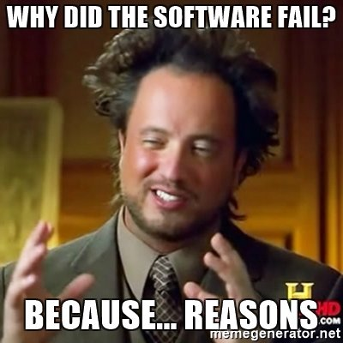
Because Failure Happens
Notes:
Reliability and robustness are notoriously hard to achieve (actor model systems have achieved 9 9s of reliability… < 1/10 second of downtime per year)

Slide 12
The Basics

Slide 13
What Is An Actor?
An actor is a container for…
State – data owned by and visible only to the actor
Behavior – logic that acts upon the actor’s state
ID – a unique identity that spans the actor system
A Mailbox – a unique location for other actors to send messages to the actor
Children – zero or more actors created by and supervised by the actor
A Supervisor Strategy – an explicit recipe for handling child failures

Slide 14
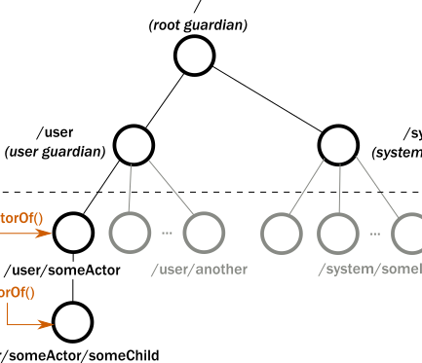
Everything Is An Actor

Slide 15
All Communication via Async Messages
Actors do nothing until they receive a message
Upon receiving a message, they can:
Create other actors
Send messages to other actors (or themselves)
Modify their own state
Actor runtime ensures an actor processes only one message at a time
Messages are immutable (!)

Slide 16
Supervision
Formal delegation of failure handling to knowledgeable party
Parent actor is responsible for handling failures in its children
Possible choices:
Do nothing
Restart the child, possibly resetting its internal state
Terminate the child
Ask its own parent what to do

Slide 17
Actors in .NET

Slide 18
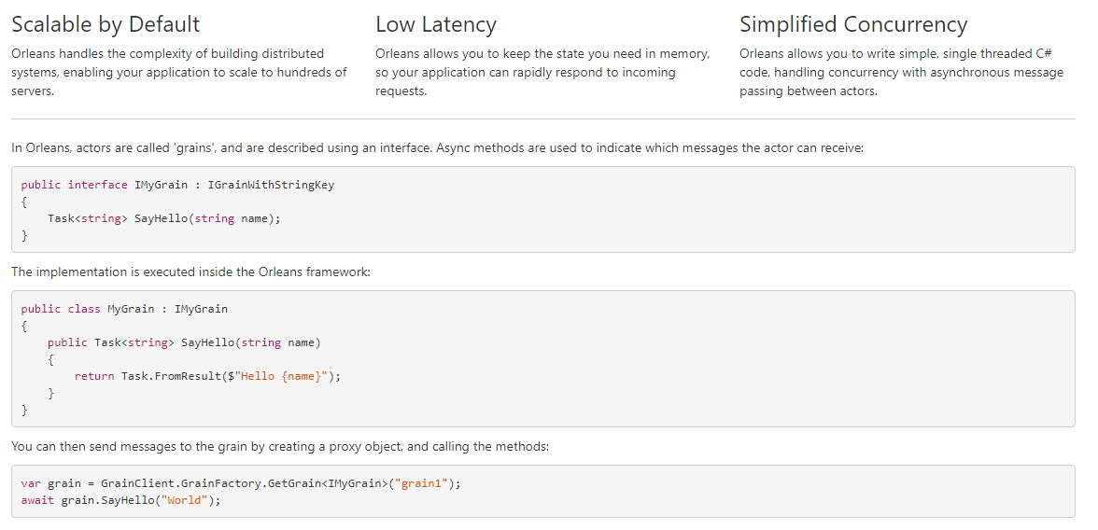
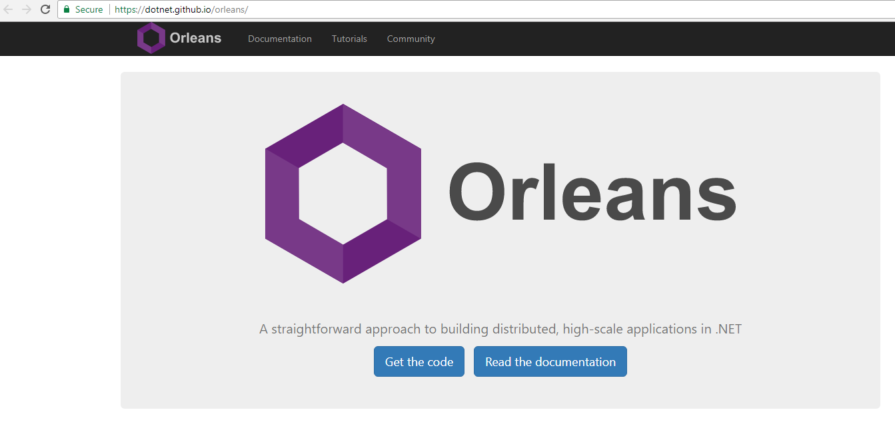
Microsoft Orleans
Notes:
OSS from MS Research… used to build Halo online games
“Grains” that exist in “silos”
Introduced concept of virtual actors (location and lifetime transparency)
Attempts to hide most implementation and config details of distributed systems programming from programmer
Implements errors as exceptions propagated back to caller
No formal concept of actor supervision

Slide 19
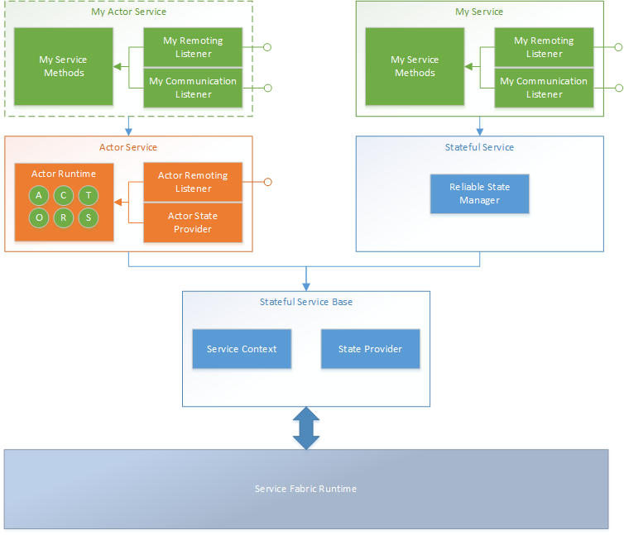
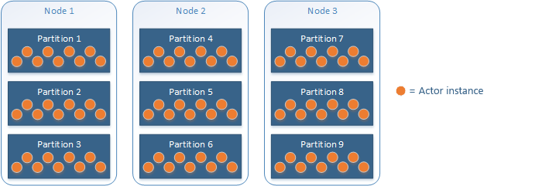
Azure Service Fabric Actors
Notes:
Integrated with Service Fabric Reliable Services runtime model
Has concept of virtual actors (location and lifetime transparency)
Attempts to hide most implementation and config details of distributed systems programming from programmer
Implements errors as exceptions propagated back to caller
No formal concept of actor supervision
Utilizes SF’s built-in replicated local storage feature

Slide 20
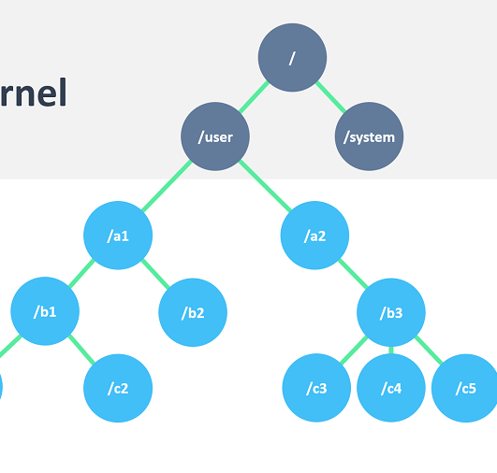
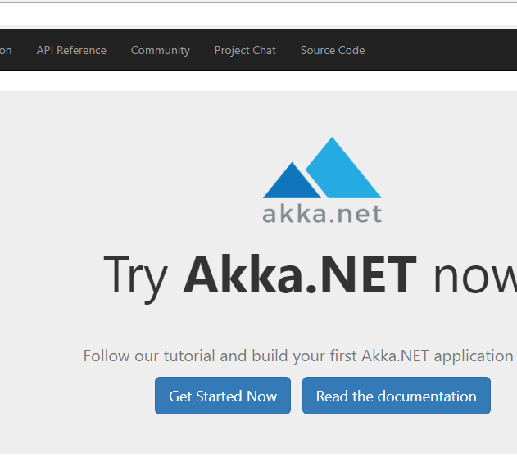
Akka.NET
Notes:
.NET port of Java-based Akka framework
Actors are not virtual (you explicitly manage their lifetime and sometimes their location)
Provides various abstraction levels for programmer to build a distributed system upon (must understand how distributed systems work)
Errors are part of modeled application protocol; exceptions are propagated to supervisors who decide how children should respond

Slide 21

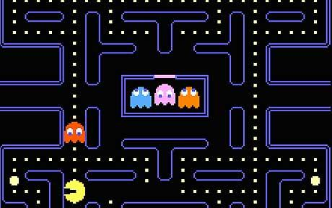

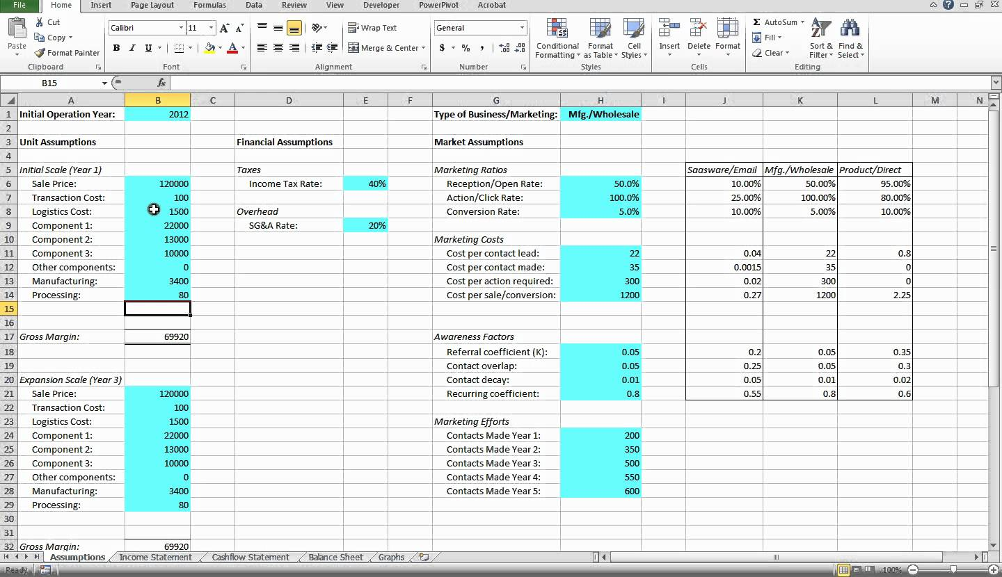
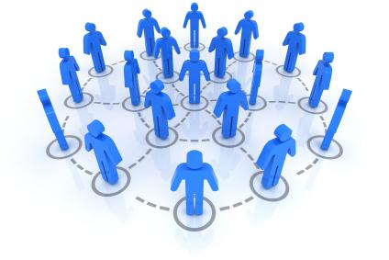
Use Cases
Notes:
Highly concurrent, distributed computation
Many atomic instances in the domain (even millions!)
IoT, gaming, scientific computing, financial modeling, social networks, etc.

Slide 22
Which Framework?
 | Main features | Drawbacks | Choose if…
MS Orleans | Virtual actors Strong OSS ecosystem | No official support | Relatively simple start + proven tech
SF Actors | Virtual actors Part of SF ecosystem (replicated state, SxS upgrades, etc.) | Not OSS | Simplest start + SF integration
Akka.net | Formal actor semantics (state machine, supervision) OSS ecosystem | Complexity | Want formal actor semantics, or coming from Akka or Erlang

Slide 23
Thank you!
http://www.brianstorti.com/the-actor-model/
https://en.wikipedia.org/wiki/Actor_model
https://channel9.msdn.com/Shows/Going+Deep/Hewitt-Meijer-and-Szyperski-The-Actor-Model-everything-you-wanted-to-know-but-were-afraid-to-ask
https://docs.microsoft.com/en-us/azure/service-fabric/service-fabric-reliable-actors-introduction
http://getakka.net/index.html
https://dotnet.github.io/orleans/index.html

